Slide 1


Academic Collaboration Between Dalanj University and Alfa University
Strengthening Academic, Research, and Cultural Ties

Slide 2
Welcome to Dalanj University
About Dalanj University
University at a Glance
Founded: 1994–1995
Type: Public University
Location: Dalanj, South Kordofan State, Sudan
12
17K+
Key Facts
Faculties
Students
Established by Presidential Decree No. 67 under the Higher Education Revolution
Academic Faculties + Graduate School & Research Centers
Over 17,000 enrolled
Dedicated to expanding access to quality education across all segments of Sudanese society
500+
25K+
Plays a central role in regional development through teaching, research, and community service
Academic Staff
Graduates
Professors and lecturers
Alumni contributing locally and globally
Community Engagement: Strong focus on rural development and women's empowerment.

Slide 3
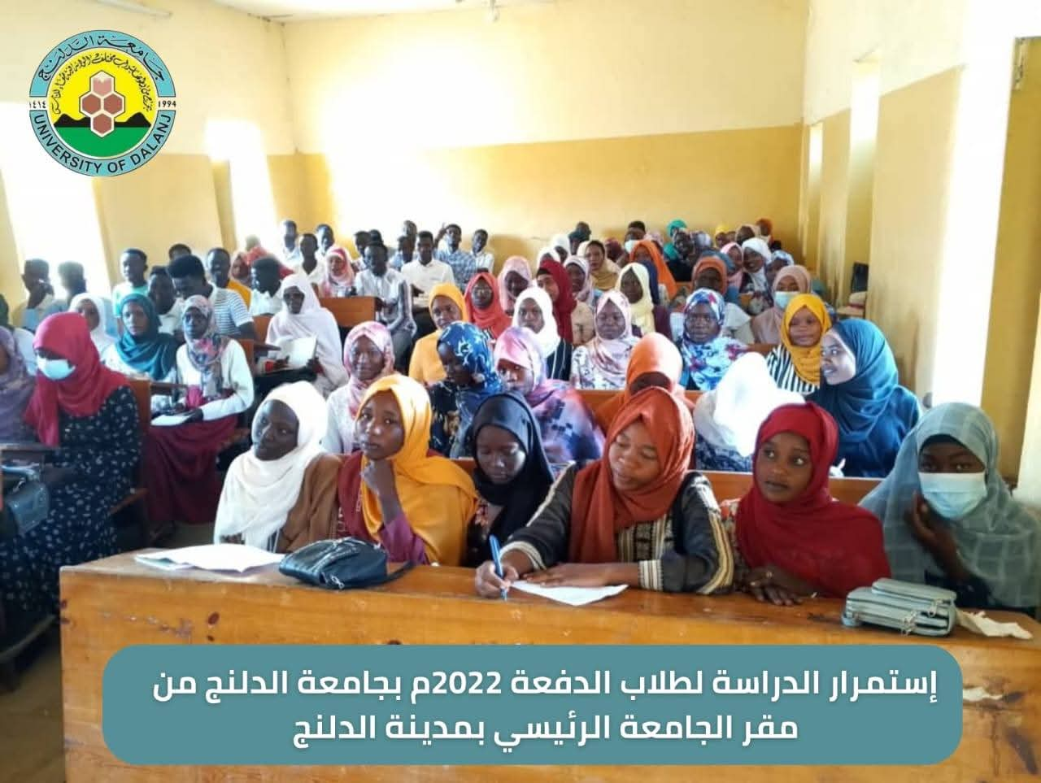

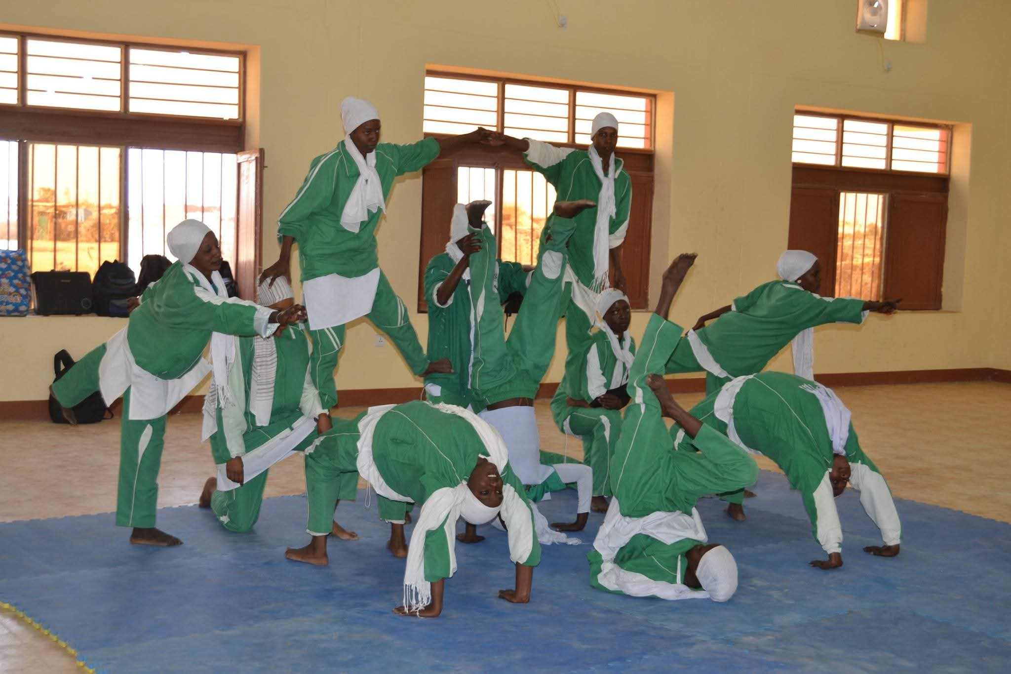

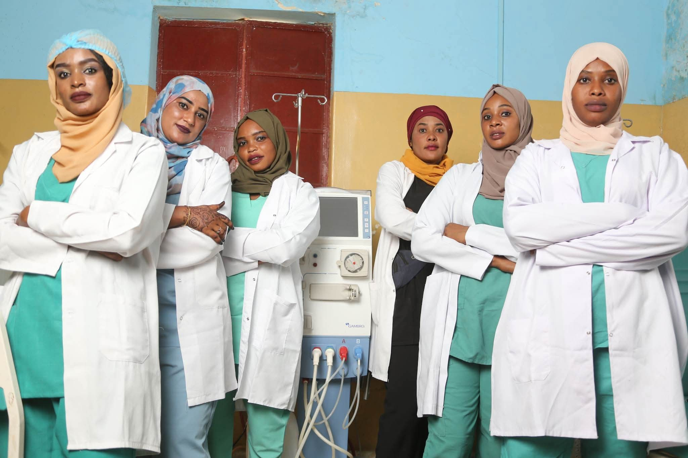
Vision & Mission of Dalanj University
Vision
To be a leading institution in scientific research, education, and community service, fostering innovation and sustainable development within Sudan and beyond.
Mission
To offer distinguished academic programs and research that serve society, contribute to national development, and address contemporary challenges through quality education and community engagement.

Slide 4
Strategic Objectives & Educational Focus
Promote National Identity
1
Through tailored curricula that embrace cultural heritage.
Scientific Research
2
Conducting applied research to meet societal needs and address environmental challenges, particularly in South Kordofan.
Community Engagement
3
Empowering rural communities and advancing human development.
Specialized Sciences
4
Prioritizing agriculture, medical, and veterinary sciences for national growth.
International Collaboration
5
Working with national and international institutions for sustainable development and granting recognized academic qualifications.

Slide 5
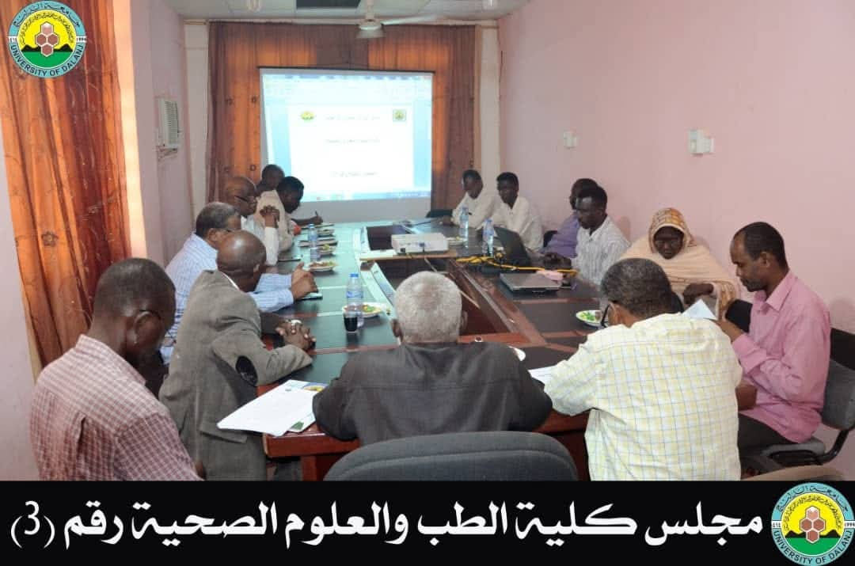
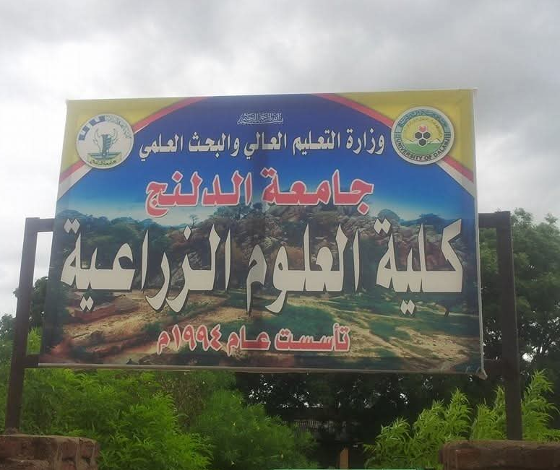
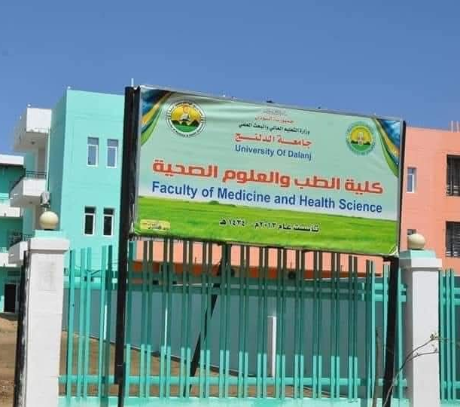
Academic Faculties & Programs
Dalanj University offers a comprehensive range of academic programs across diverse fields, designed to meet the evolving demands of the job market and societal needs.
Medicine & Health Sciences: MBBS, Nursing, Public Health, Midwifery, Medical Assistance Diplomas
Agricultural Sciences: Animal/Crop Production, Soil, Forestry, Agri-Engineering, Food Tech
Teacher Education: Preschool, Educational Activities, Math, Social Sciences
Computer Science & IT: Computer Science, IT, Information Systems, Diplomas
Physical Education: Health & Recreation, Supervision, Sports Science
Economic & Social Studies: Accounting, Business, Sociology, Economics, Public Administration
Community Development: Women’s Empowerment, Capacity-Building Programs
Basic Sciences: Zoology, Chemistry, Physics, Mathematics & Computer Science
Graduate Studies: Master’s and PhD programs across disciplines
Education: Islamic Studies, Arabic, English, Geography, History, Science Teaching
Earth Sciences: Mining, Petroleum, Environmental & Engineering Geology
Sharia & Law: BSc in Sharia, BSc in Law (curriculum coordination ongoing)

Slide 6
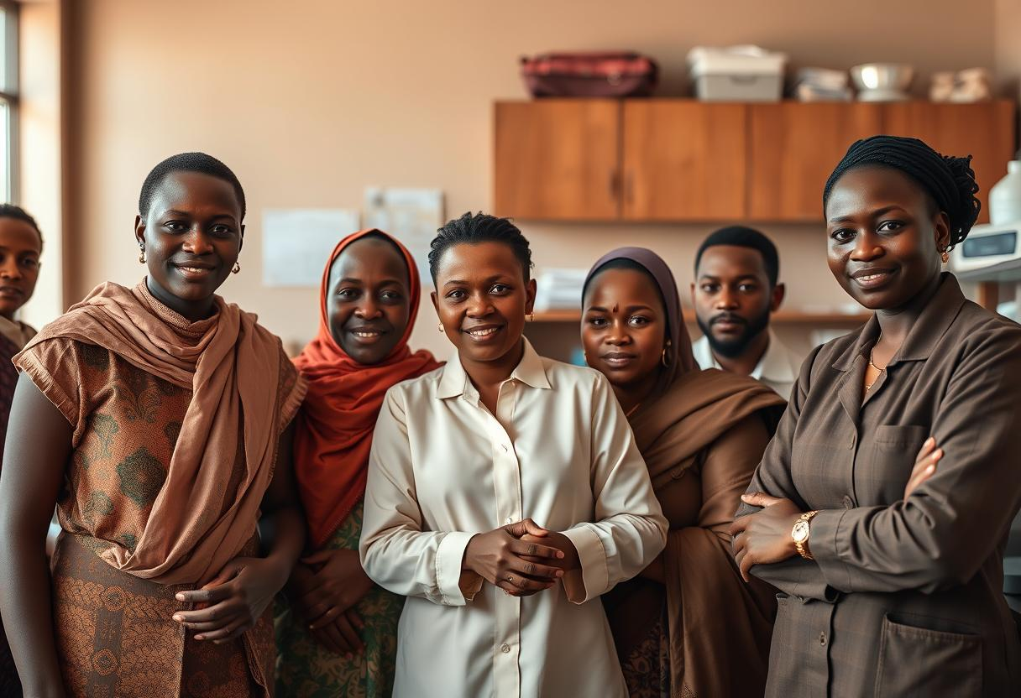
Research Centers & Community Engagement
Major Centers
Community Focus
Informatics Center
Peace & Development Studies Center
Human Resources Development Center
Psychological Support & Counseling Center
Dalanj University is deeply committed to community development, fostering partnerships in women's empowerment, psychological support, and peacebuilding initiatives. We actively engage in rural development projects across South Kordofan, leveraging our academic expertise to address local challenges and uplift communities.
Biotechnology Center
Popular Heritage Center

Slide 7





Importance of International Partnerships
Global Exchange
Collaborative Research
Diverse Methodologies
Facilitating the exchange of academic expertise and fostering innovation through diverse perspectives.
Engaging in joint research initiatives to tackle both local and global challenges effectively.
Accessing varied educational methodologies and approaches, enriching the learning experience for students and faculty.
Cultural Understanding
Grant Access
Promoting cultural exchange and mutual understanding between institutions and nations.
Gaining greater access to international grants, cutting-edge technologies, and advanced learning tools.

Slide 8
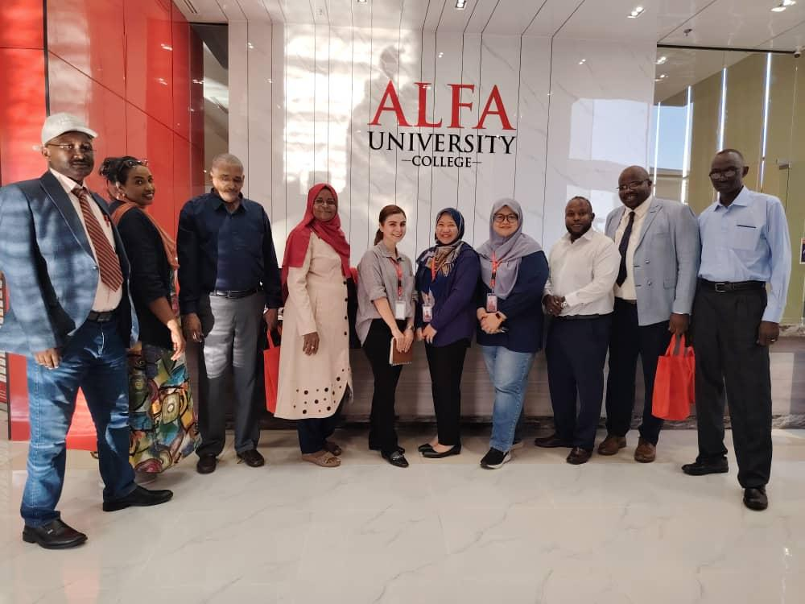
Highlighted Collaboration with Alfa University
Strategic Academic Partnership
Our partnership with Alfa University College – Malaysia, signed on 11 July 2025, represents a significant step in our internationalization efforts.
Focus Areas:
Design, Business, and Educational Innovation
Curriculum development and review
Faculty and student exchange programs
Joint workshops and collaborative research initiatives

Slide 9
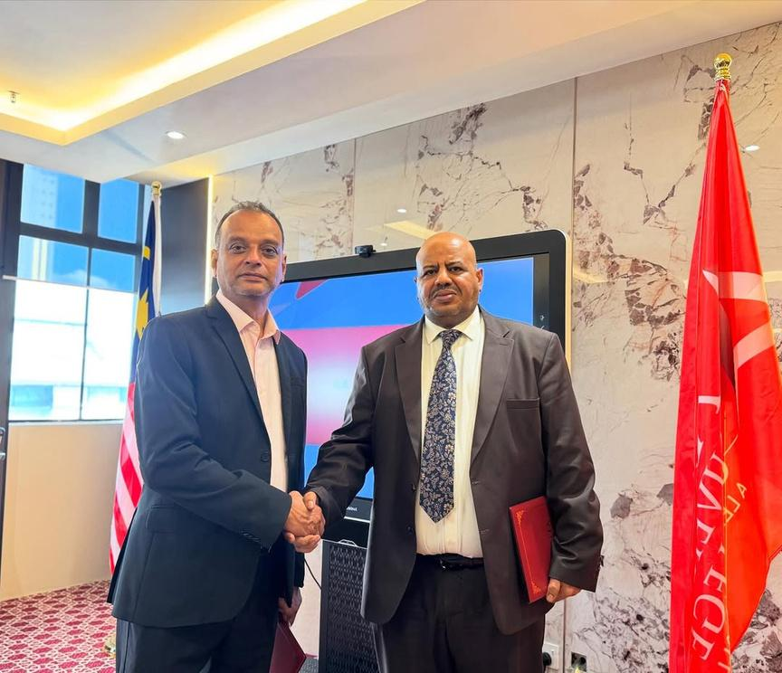

Expanding Global Reach: MOUs and Twinning Agreements
In addition to our foundational partnership with Alfa University College, Dalanj University is actively initiating other twinning agreements with regional and international institutions.
Research Enhancement
To significantly enhance our research capabilities through shared resources and expertise.
Institutional Capacity
To improve institutional capacity and operational efficiency through best practices exchange.
Academic Exchange
To promote academic exchange and foster multicultural learning environments for students and faculty.
Curricula Alignment
To align our curricula with international standards, ensuring global relevance for our graduates.

Slide 10
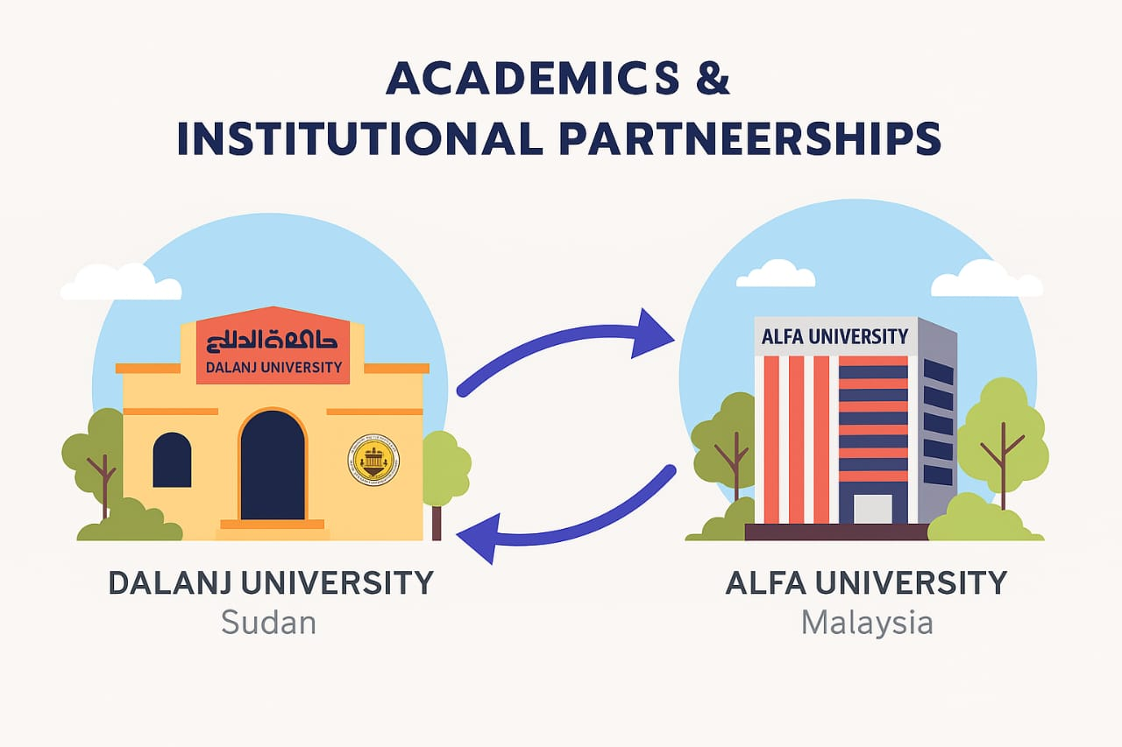
Fostering Global
Academic Partnerships
Unlocking new opportunities through international collaboration.

Slide 11
Benefits & Goals of Our Collaboration
Academic Benefits
Institutional Goals
Access to cutting-edge resources
Enhance global academic visibility
Cross-cultural academic exposure
Promote quality assurance & benchmarking
Faculty & curriculum development
Build international academic networks
Joint supervision & innovation
Extend regional accessibility
Shared learning experiences

Slide 12



Strategic Expansion Initiatives
New Main Campus in Port Sudan
Cairo Branch Expansion
Digital Infrastructure Focus
Final stages of development to serve North African students.
A new university building is currently under construction.
Emphasis on smart classrooms and advanced e-learning platforms.

Slide 13
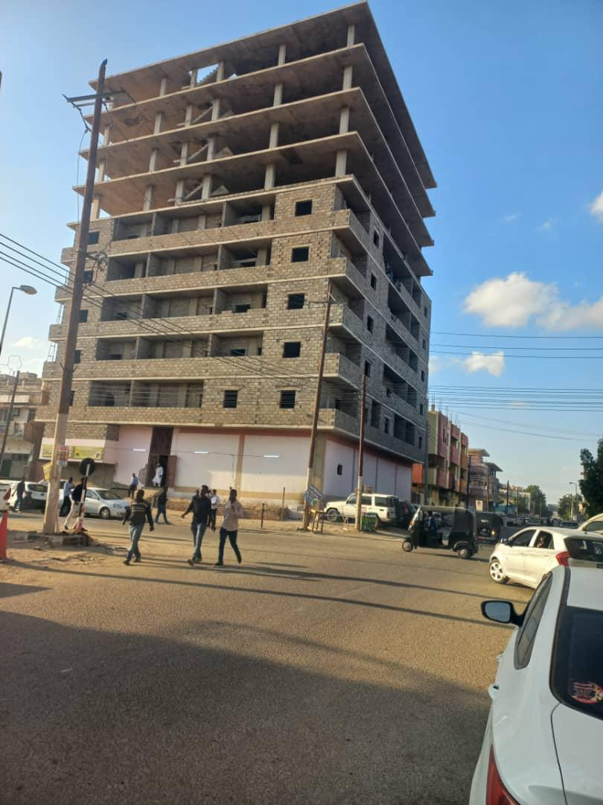
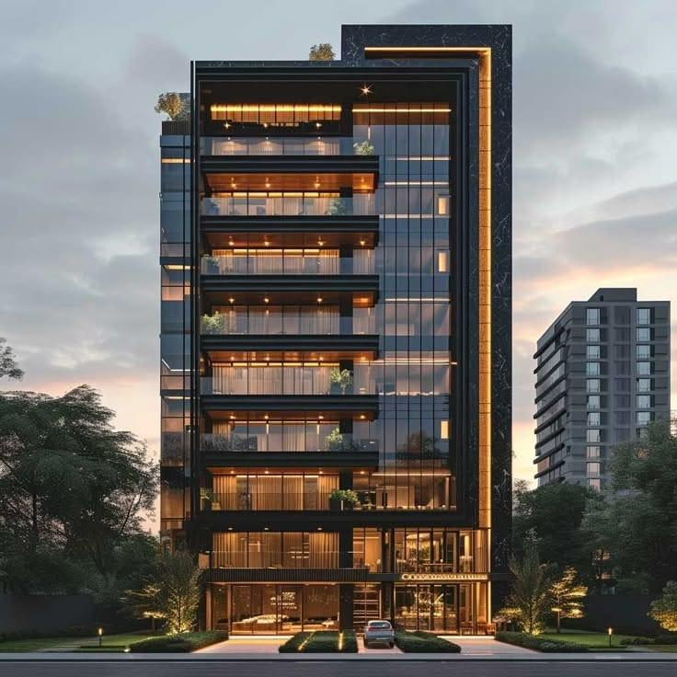
Al Dalanj University Port Sudan New Campus
Under construction (Final Stage)

Slide 14
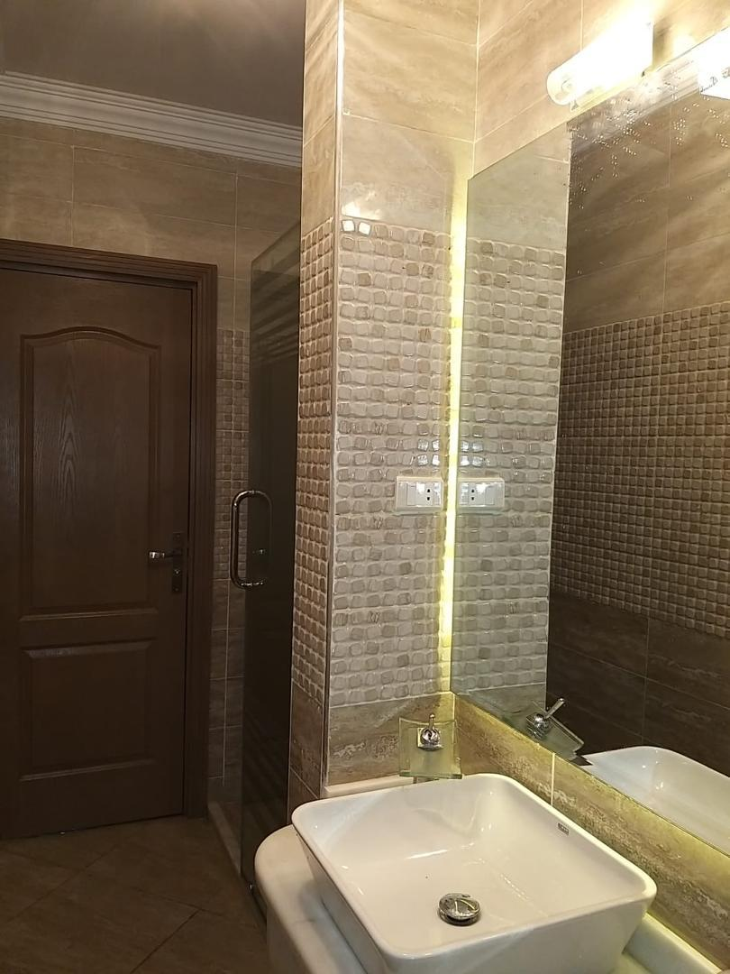
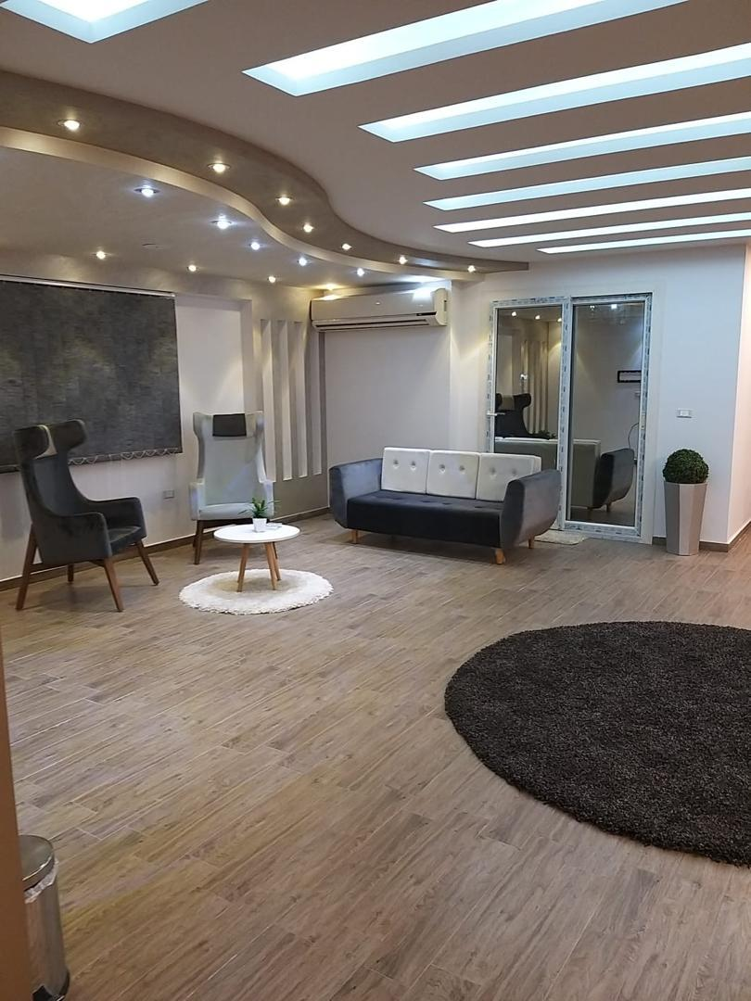

Cairo Branch Expansion
Construction is nearly finished, and the building will be ready for opening in two weeks

Slide 15
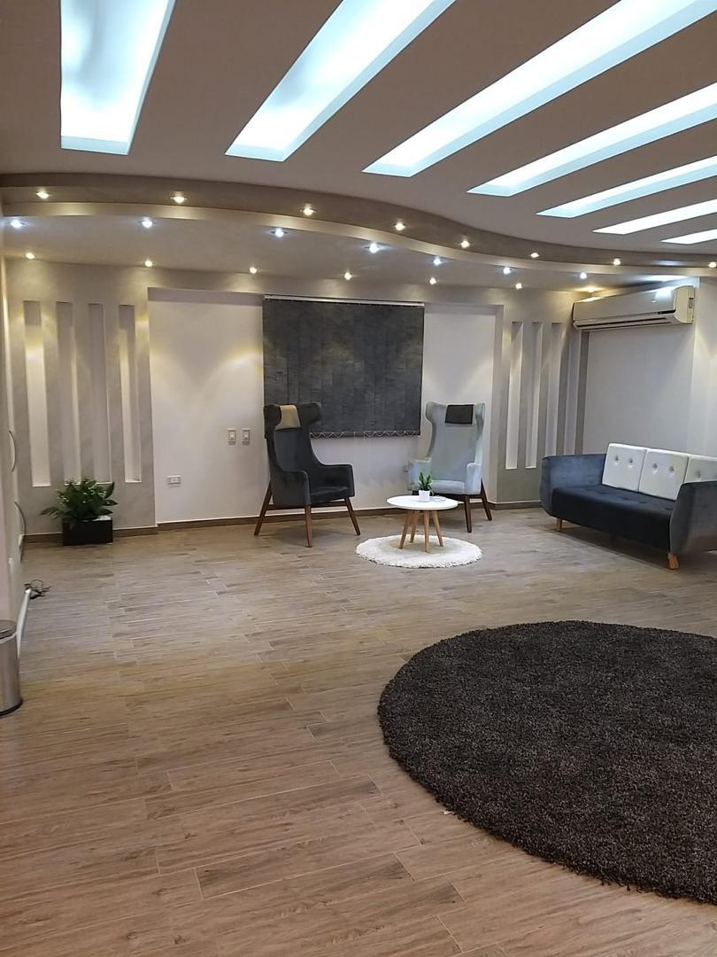
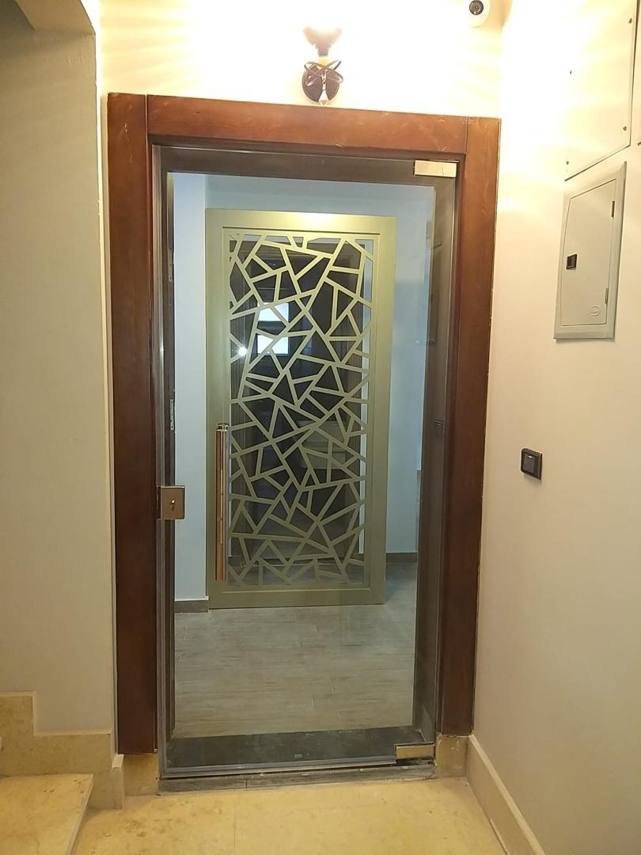
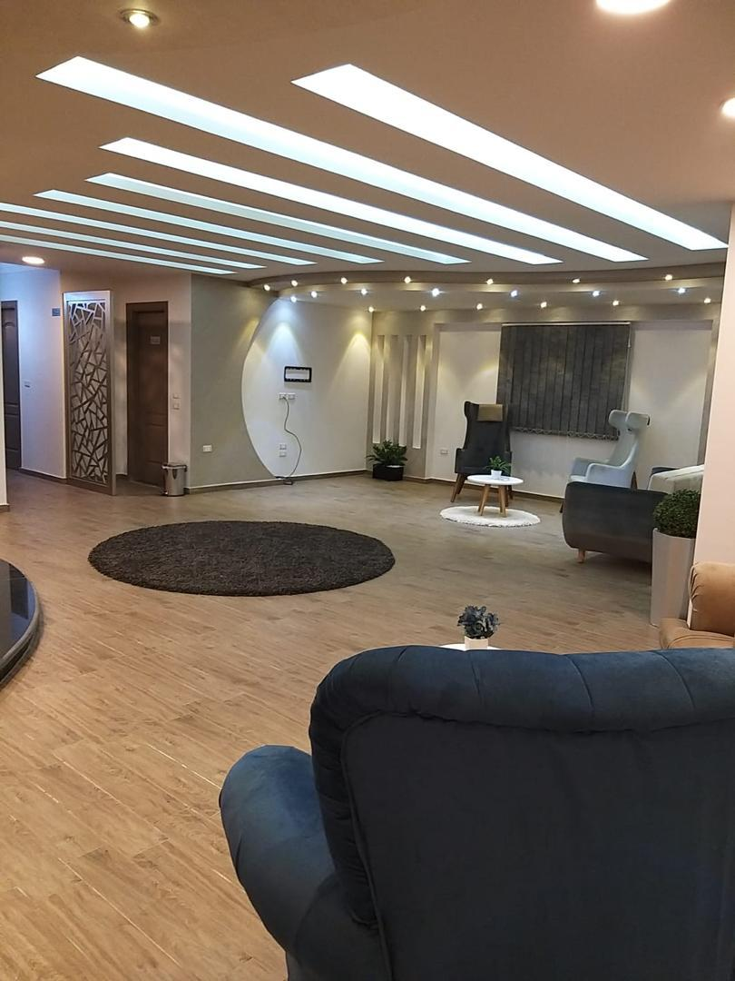

Slide 16

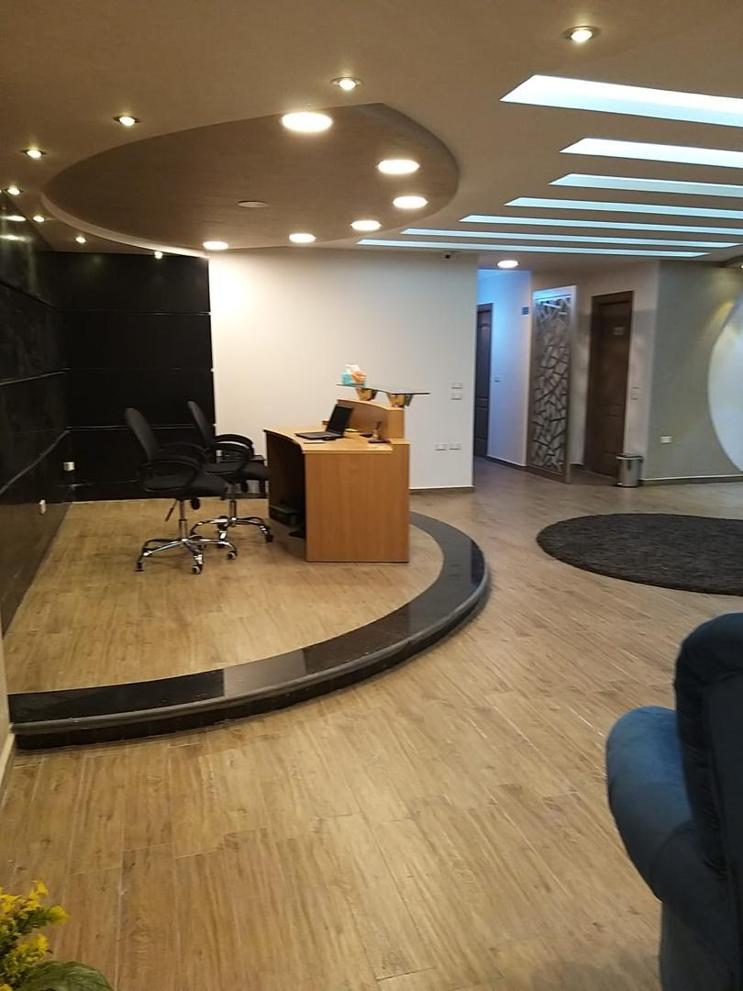
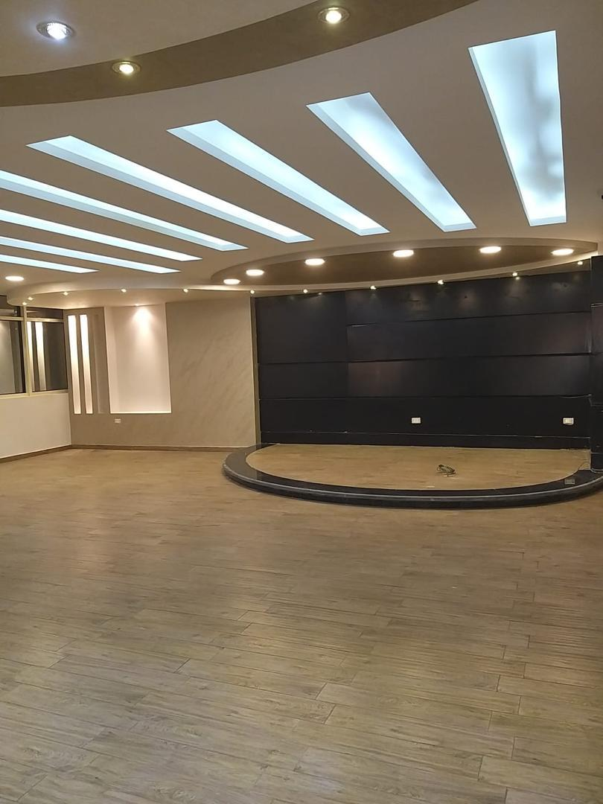

Slide 17
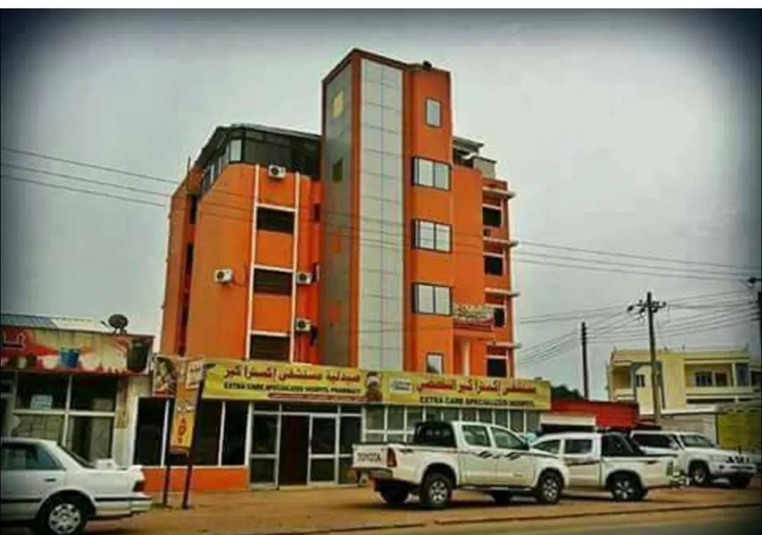
AL – Dalanj University Hospital – El Obeid Branch
This upcoming facility in El Obeid is dedicated to the Faculty of Medicine at Al Dalanj University.
It will serve as a teaching hospital and is expected to open soon.

Slide 18
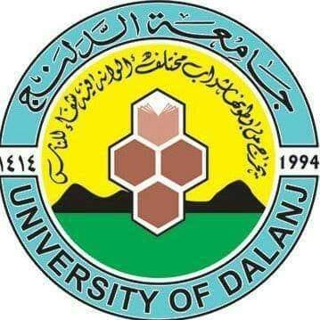
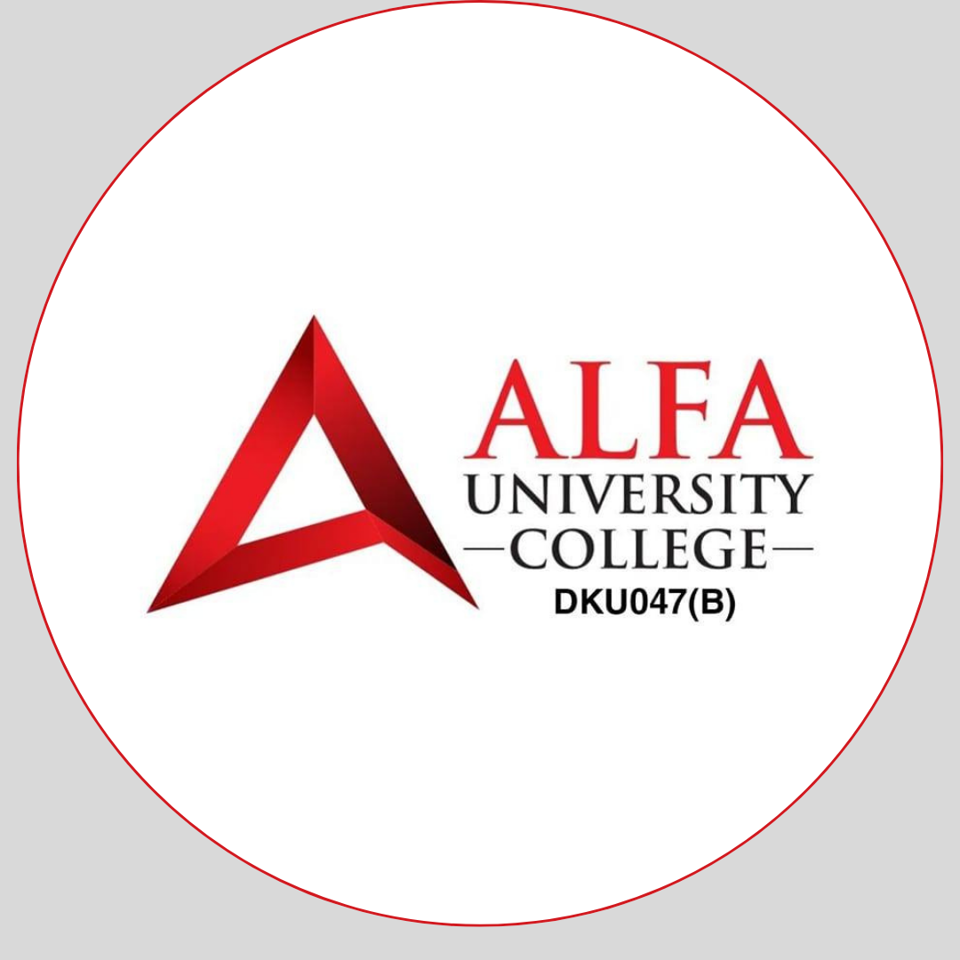
Building Bridges of Knowledge
Thank you for your interest in meaningful academic collaboration.
Connect with us:
📧 Email: info@uofdalanj.edu.sd
🌐 Website: https://uofdalanj.edu.sd

